Slide 1

ADITYA COLLEGE OF ENGINEERING & TECHNOLOGY(A) Approved by AICTE, New Delhi & Affiliated to JNTUK, Kakinada Accrediated by NAAC(A+) and NBA Surampalem, Kakinada District, Andhra Pradesh-533 437 (2023-2027)

Slide 2
Daily Task Reminder Via Email
Cloud services

Slide 3
Team Members Karri Bhavya Satya Sri 23P31A0533 Akkina Sravanthi Sai Lakshmi 23MH1A05E5 Govvala Harika Deepthi 23P31A0518 Jagu Hansika 23P31A05G1

Slide 4
Introduction
Daily Task Reminder via Email is a cloud-based project that helps users remember their daily tasks by sending automated email reminders at scheduled times. Built using Flask and deployed on AWS EC2, it uses Amazon SES for sending emails and CloudWatch for logging.

Slide 5
Objective
To develop a cloud-based application that allows users to schedule tasks and automatically receive email reminders at the specified time, enhancing time management, productivity, and task organization.

Slide 6
Benefits
✅ Improves Time Management
📩 Automated Email Alerts
⏱️ Reduces Missed Deadlines
🌐 Cloud-Based
🔒 Secure and Reliable
💻 User-Friendly Interface

Slide 7
Technology Used - Python
This project is developed using Python as the core programming language. Python is used to build the backend logic with the Flask framework, which handles task scheduling, email sending, and integrates with AWS services like SES and CloudWatch.

Slide 8
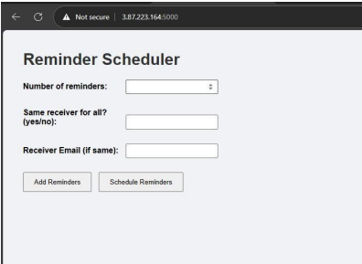

Slide 9
Cloud Services Used
Amazon EC2
Amazon SES
IAM
Amazon CloudWatch Logs
Amazon S3

Slide 10
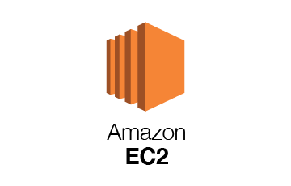
Amazon EC2
Amazon EC2 is a virtual computer in the cloud. It lets you run websites or applications just like a normal computer. In this project, it is used to run the Flask app so that it works online all the time.

Slide 11
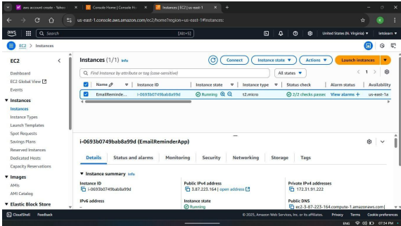

Slide 12

Amazon SES
Amazon SES is a cloud service used to send emails. It is reliable, fast, and used for sending notifications or reminders. In this project, it is used to send task reminder emails to users automatically

Slide 13
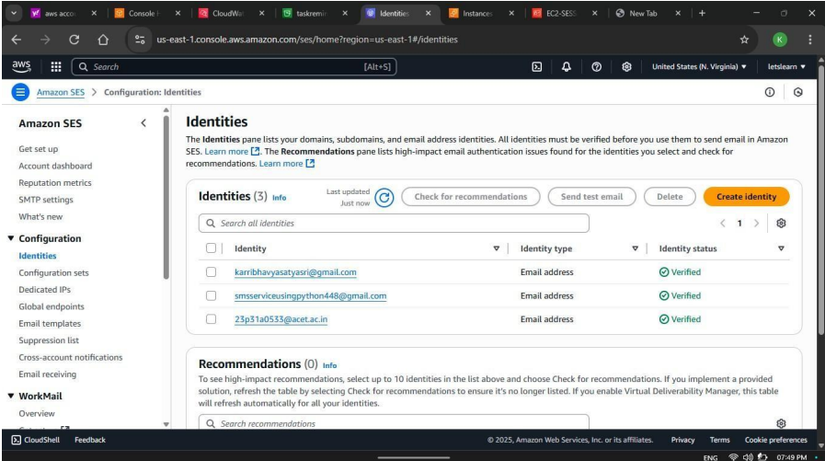

Slide 14

IAM (Identity and Access Management)
IAM is used to manage permissions in AWS. It controls who can access what services and resources. In this project, IAM is used to securely give access to services like SES and CloudWatch.

Slide 15
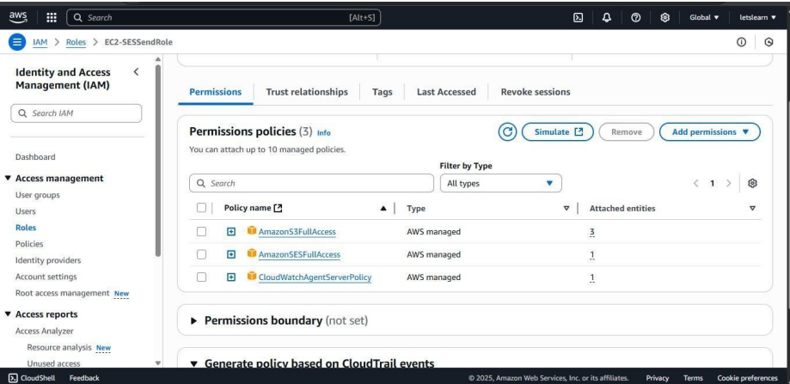

Slide 16
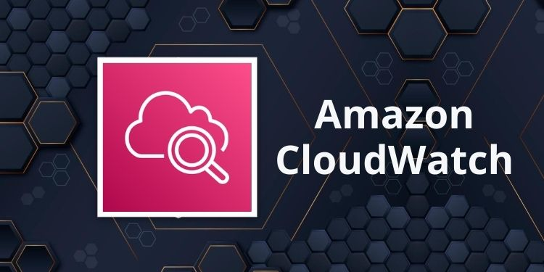
Amazon CloudWatch Logs
CloudWatch Logs is used to monitor and store logs from your application. It helps you track errors, performance, and activities in your app. In this project, it is used to store logs like task reminders or errors for debugging

Slide 17
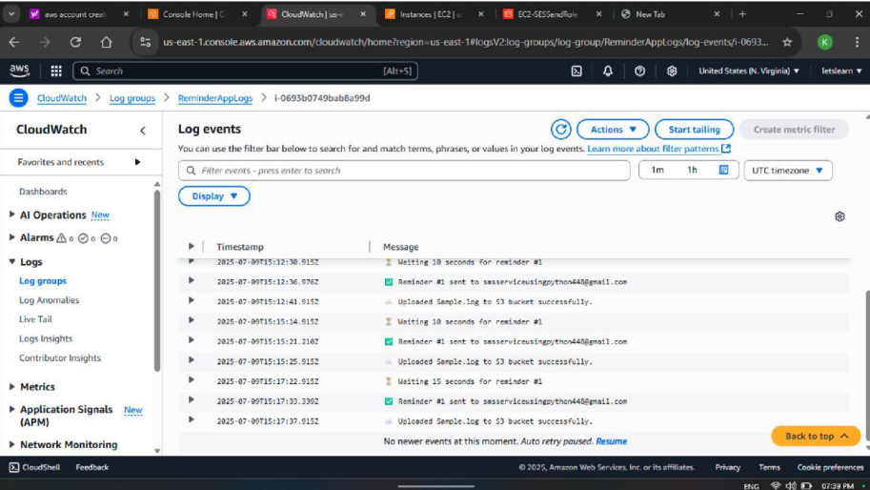

Slide 18
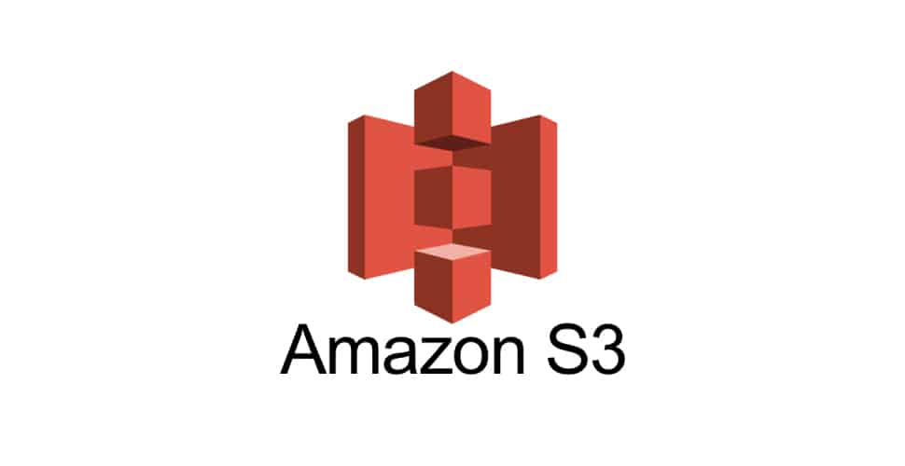
Amazon S3
Amazon S3 is used to store files in the cloud. It can hold images, documents, HTML files, and more. In this project, it can be used to store templates or backups if needed.

Slide 19
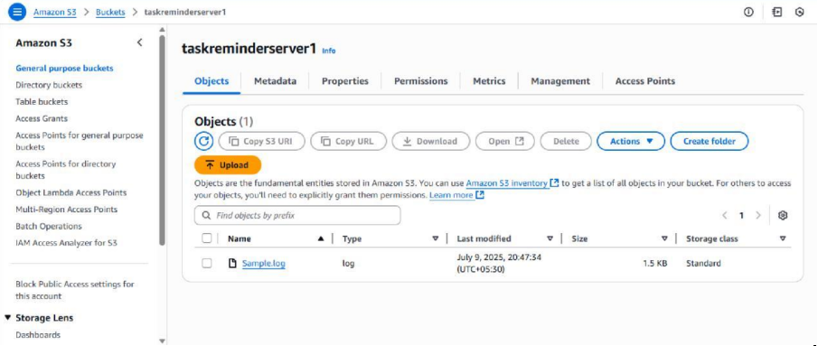

Slide 20
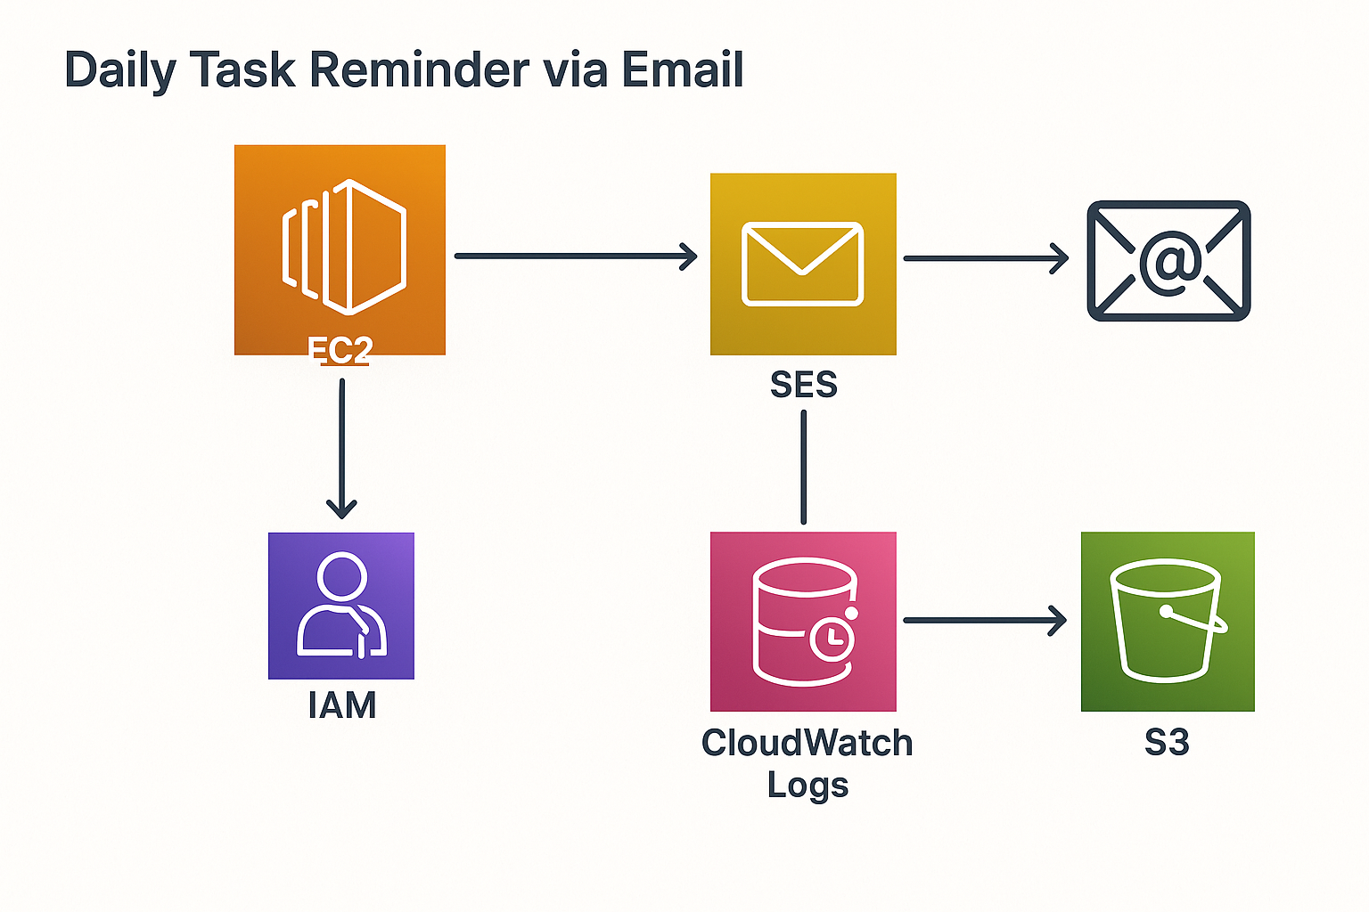

Slide 21
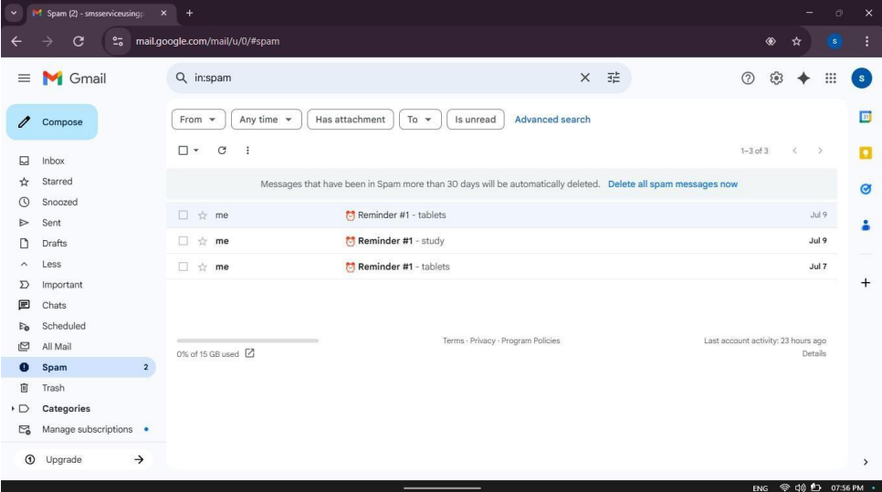
Result

Slide 22
Conclusion
The Daily Task Reminder via Email project successfully demonstrates how cloud technologies can be used to automate and simplify daily task management. By integrating Python with AWS services like EC2, SES, IAM, CloudWatch, and S3, the system offers a reliable, user-friendly, and scalable solution for sending timely task reminders. This project not only improves productivity but also showcases the practical use of cloud computing in real-life applications.

Slide 23


